Slide 1

Huazhong University of Science and Technology
The Department of Electronics and Information Engineering
Electronic Circuit Analysis and Design
Dr. Tianping Deng
Email: dengtp@hust.edu.cn

Slide 2
Contents
PART 1 SEMICONDUCTOR DEVICES AND BASIC APPLICATIONS
Chapter 1 Semiconductor Materials and Diodes
Chapter 2 Diode Circuits
Chapter 3 The Field-Effect Transistor
Chapter 4 Basic FET Amplifiers
Chapter 5 The Bipolar Junction Transistor
Chapter 6 Basic BJT Amplifiers
Chapter 7 Frequency Response
Chapter 8 Output Stages and Power Amplifiers
PART 2 ANALOG ELECTRONICS
Chapter 9 Ideal Operational Amplifiers and Op-Amp Circuits
Chapter 10 Integrated Circuit Biasing and Active Loads
Chapter 11 Differential and Multistage Amplifiers
Chapter 12 Feedback and Stability
Chapter 13 Operational Amplifier Circuits
Chapter 14 Nonideal Effects in Operational Amplifier Circuits
Chapter 15 Applications and Design of Integrated Circuits
Chapter 14 Nonideal Effects in Operational Amplifier Circuits

Slide 3
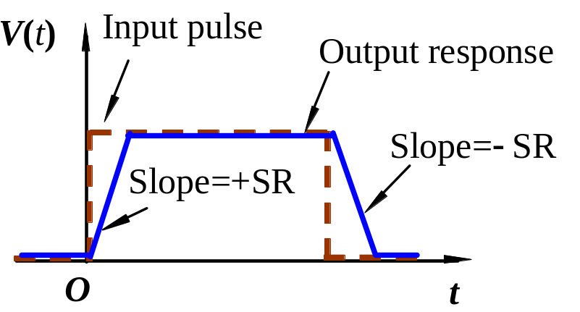
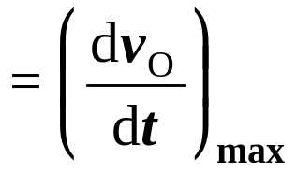
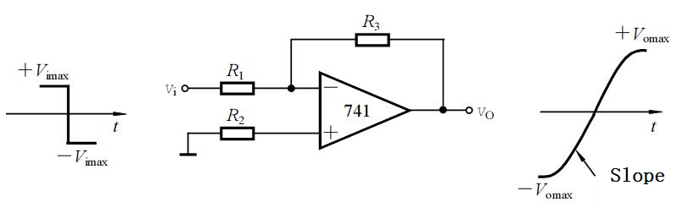
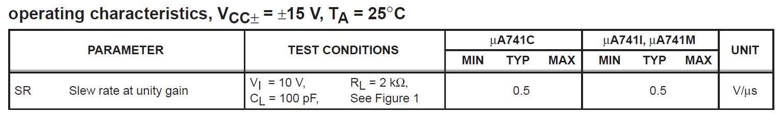
Ch14 Nonideal Effect in Practical Operational Amplifier
1. Slew rate
Slew rate SR
Slew rate is defined as a positive quantity.

Slide 4
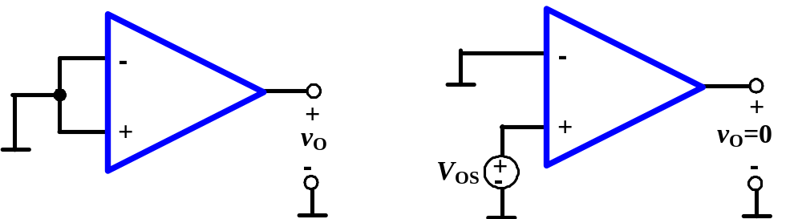
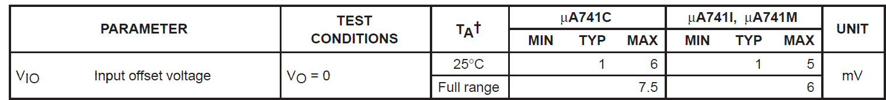
2. Input offset voltage
It is defined as the input diff voltage applied to the open-loop op-amp to produce a zero output voltage.

Slide 5
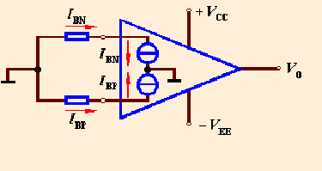

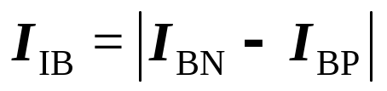
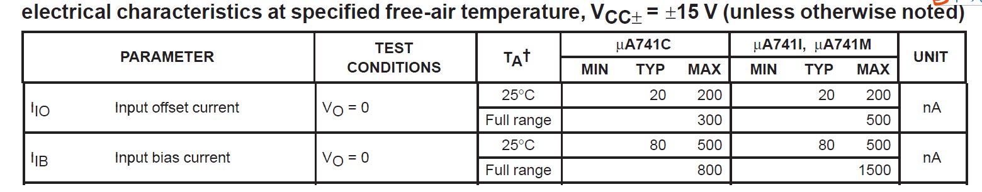
14.1 Practical Operational Amplifier Parameter
3. Input biasing current
4. Input offset current
Input biasing current

Slide 6
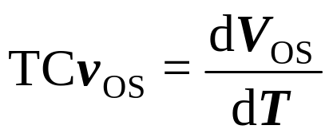
14.1 Practical Operational Amplifier Parameter
5. Temperature effect
(1) Input offset voltage drift
Input biasing current
The rate of change of offset voltage with temperature.

Slide 7
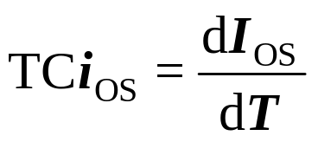
14.1 Practical Operational Amplifier Parameter
(2) Input offset current drift
The rate of change of offset current with temperature.
5. Maximum differential input voltage V_{idmax}
6. Maximum common input voltage V_{icmax}
7. Maximum output current I_{omax}

Slide 8
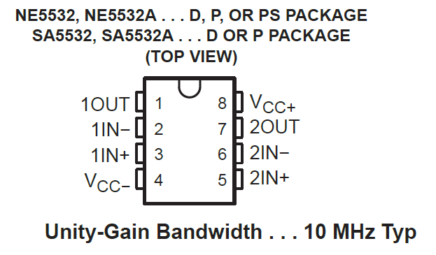
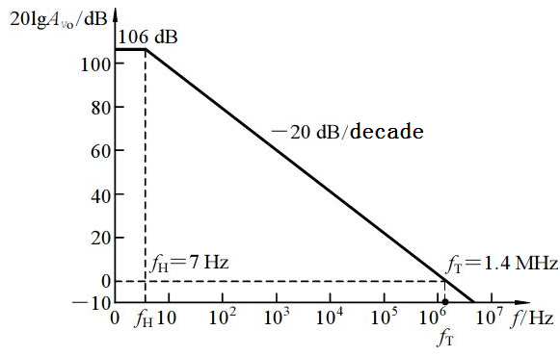
14.1 Practical Operational Amplifier Parameter
8. Open-loop diff voltage gain A_{VO}
9. Open-loop bandwidth BW (f_{H})
10. Unity-gain bandwidth BW_{G} (f_{T})

Slide 9
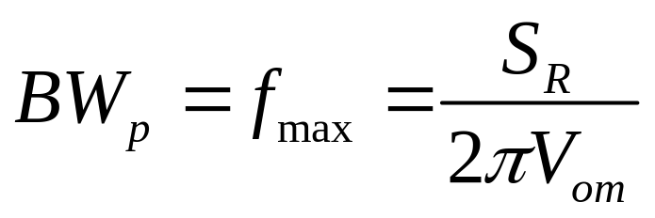
14.1 Practical Operational Amplifier Parameter
11、Full-power bandwidth
  The range of frequencies for which the op amp can produce an undistorted sinusoidal output with peak amplitude equal to the guaranteed maximum output voltage.

Slide 10
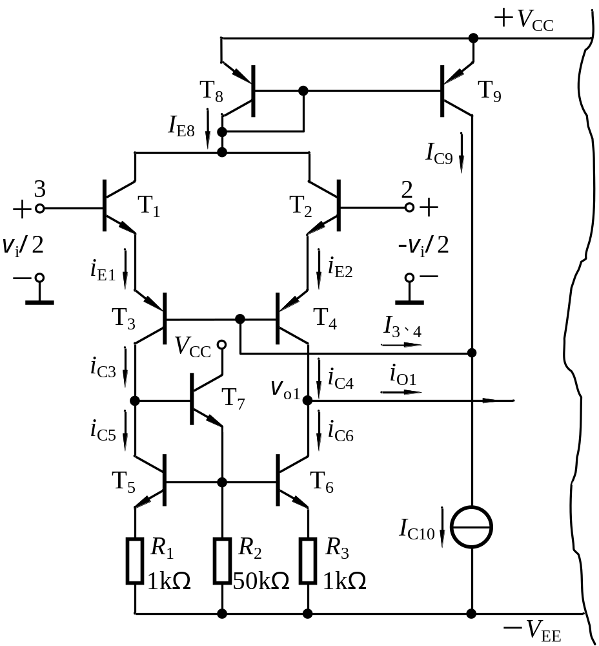

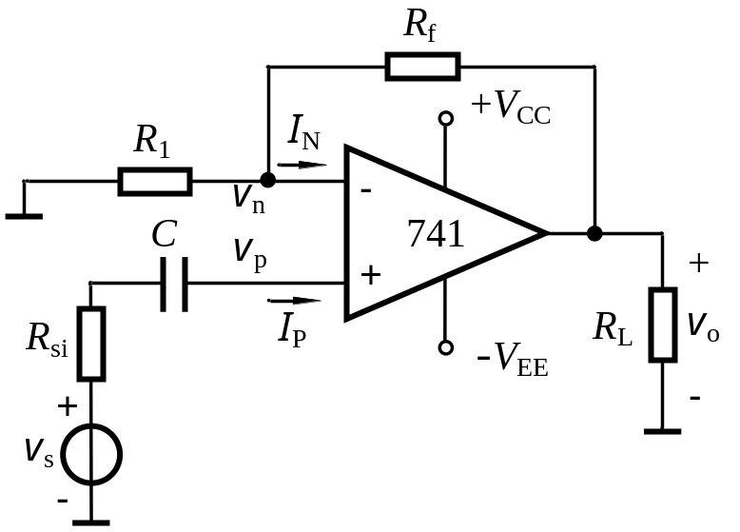

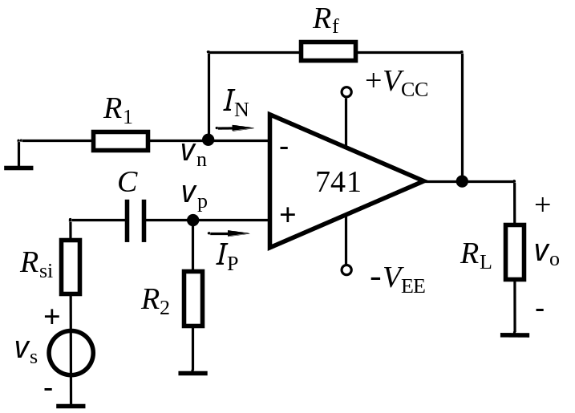
Can this circuit amplify the AC signal？
No DC circuit

Slide 11
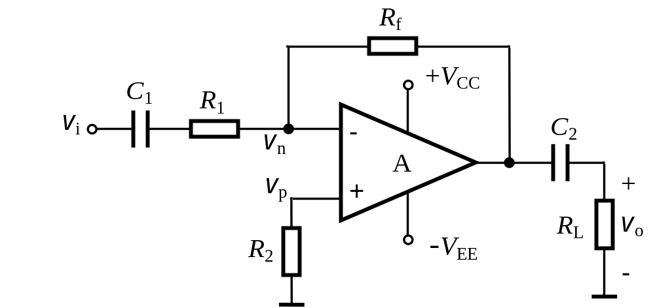

Can this circuit amplify the AC signal？

Slide 12
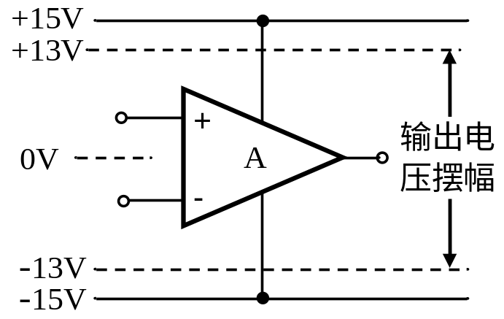
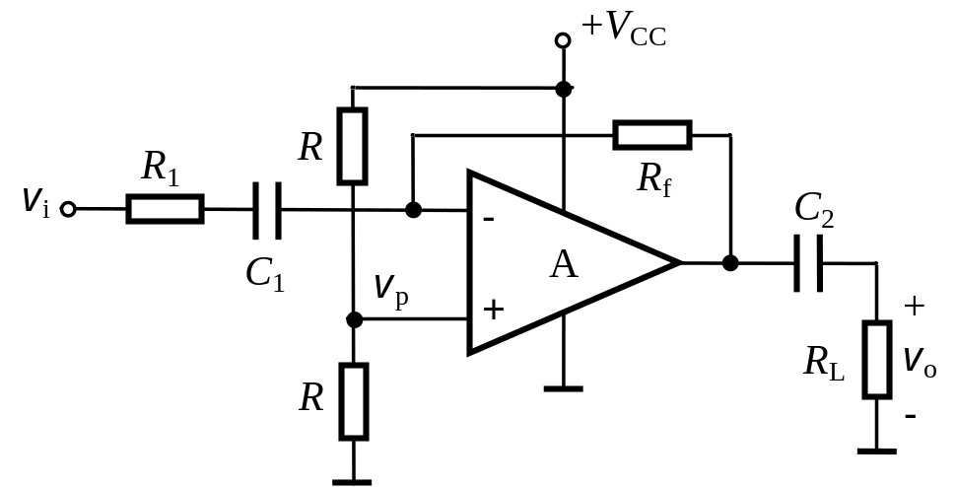
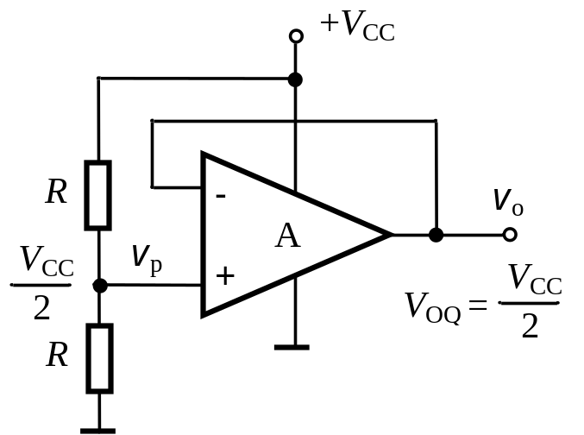
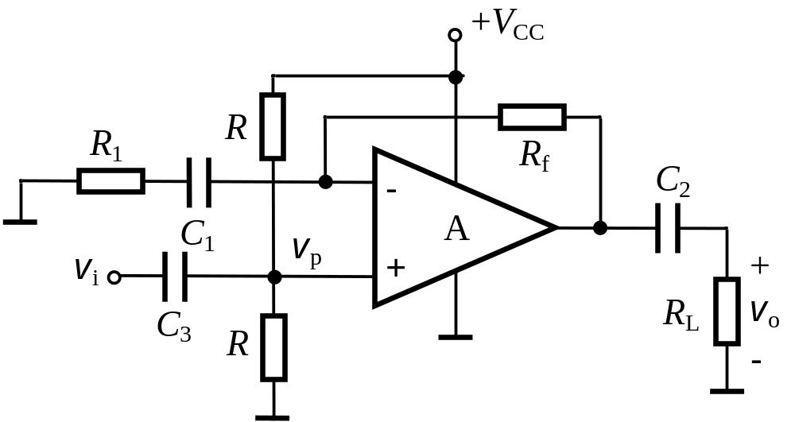
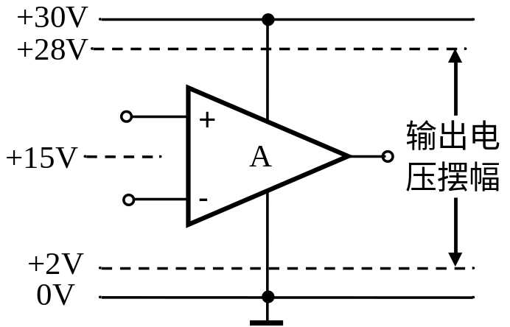
Symmetrical dual power
Single power

Slide 13

◆The output DC voltage value must be set to half of the supply voltage.
◆ The connection between signal source and load cannot affect the set static value.
◆ It is also necessary to ensure that there is a DC path between the two inputs
◆ Consider the input resistance balance condition as much as possible.

Slide 14
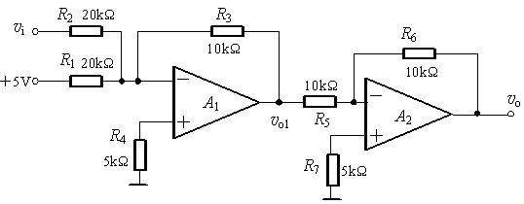
◆ Consider the input resistance balance condition as much as possible.

Slide 15
Questions
and
Answers

